Slide 1
TestNG Framework for Extensive Testing and TDD
Next Generation Testing, TestNG - Testing Tool
Narendran Solai Sridharan
19-Feb-2014

Slide 2
Table of Contents
TestNG Features & Benefits
TestNG Installation
TestNG Demo
JUnit vs TestNG
TestNG - Links

Slide 3
TestNG Overview
Features
TestNG is a testing framework inspired by JUnit and NUnit
Designed to cover all categories of tests: unit, functional, end-to-end, integration etc.,
Designed to perform Multi threaded testing, to help in load and stress testing.
Designed to Group Test Scripts and run them selectively.
Designed to run test scripts based on dependencies & failures.
Designed to check module performance such as response time with test timeouts.
Has a flexible plugin API for report creation and for even changing core behavior.
Benefits
Overcomes the drawbacks of JUNIT Framework.
One Stop Shop for various kinds of testing.
Dependency testing, grouping concept to make testing more powerful and easy.
Thins the gaps between Development and Testing and encourages Test Driven Development (TDD).
Combined use of several TestNG's features provides a very intuitive and maintainable testing design.
Easy Migration from JUNIT to TestNG.
Easy Integration with framework & tools like Spring, Selenium, Guice, Jenkins etc.
Easy Reporting

Slide 4
TestNG Installation
Pre-Requisite
Mandatory: JDK 1.5 & above & TestNG Jar
Optional: TestNG Plugin for Eclipse (any version)
Optional: Maven (any version)
Optional: JUNIT Jar, if JUNIT test cases to be run by TestNG.
Types of Installation
1. TestNG as Eclipse Plugin
2. TestNG as Maven Dependency
3. TestNG as Class Path Jar
Maven Dependency
<dependency>
<groupId>org.testng</groupId> <artifactId>testng</artifactId>
<version>6.8.6</version>
<scope>test</scope>
</dependency>

Slide 5
TestNG - Demo
TestNG XML & YAML Configuration
TestNG – “Rhythms of Testing” with Annotations.
TestNG – Groups
TestNG – Dependency
TestNG – Parameters, Data Provider & Factory
TestNG – Parallel Execution & Time Outs
TestNG – Exception Capture
TestNG – JUNIT Run
TestNG – Failure Run
TestNG – Report
Other Concepts not in Demo [Bean Shell and advanced group selection, Annotation Transformers, Method Interceptors, TestNG Listeners, Dependency injection – Refer TestNG - Links]

Slide 6
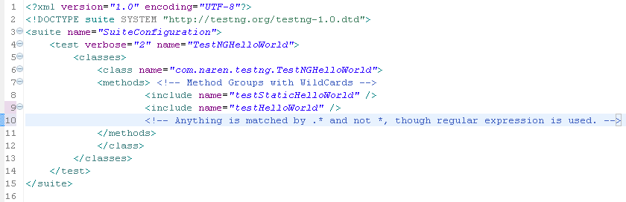
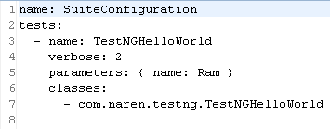
TestNG XML & YAML Configuration
XML/YAML - Entry Point of TestNG
TestNG XML Configuration
TestNG Yaml Configuration

Slide 7
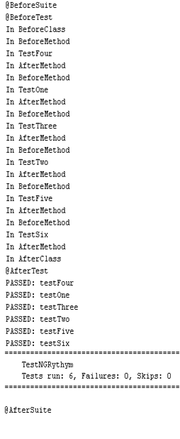
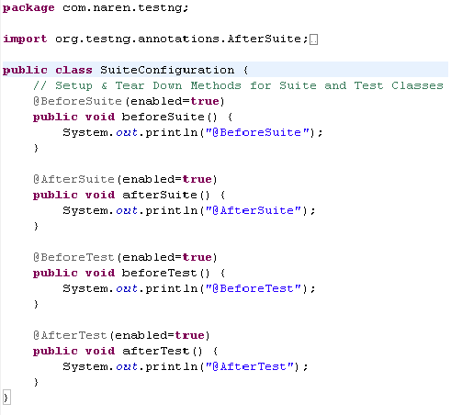
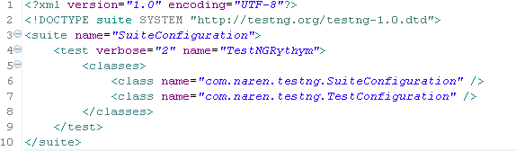
TestNG – “Rhythms of Testing” with Annotations.
The flow / Life Cycle Methods in Test in Test NG

Slide 8
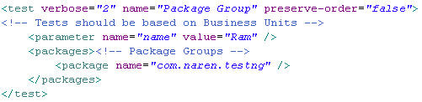
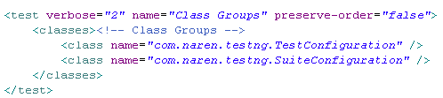
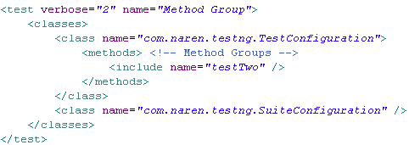
TestNG – Groups
Test class Grouping as a Package
Test class Grouping as a list of Classes
Test class Grouping as a list of Methods

Slide 9
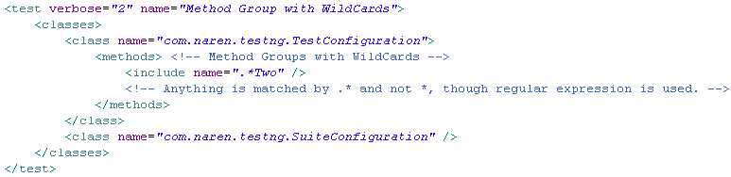

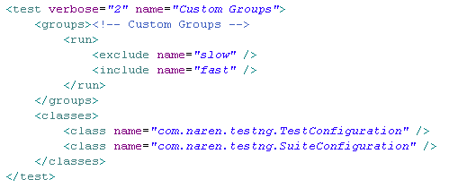
TestNG – Groups - continued
Test class Grouping as a list of wildcard methods names
Adding any method to a custom group
Test class Grouping as list of custom group of methods

Slide 10
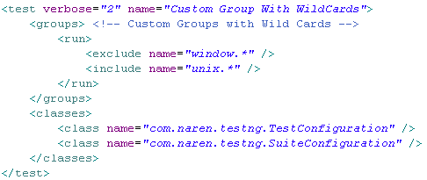
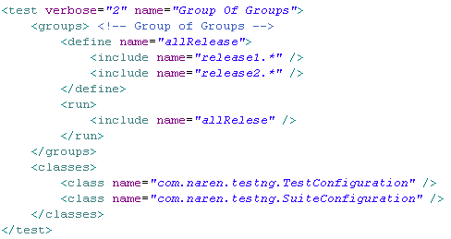
TestNG – Groups - continued
Test class Grouping as a list custom Groups with wildcards
Test class Grouping as list of Group of Groups

Slide 11
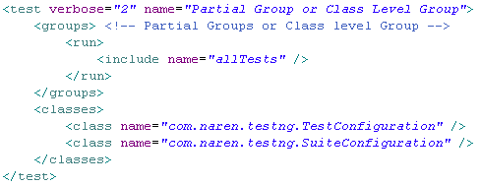

TestNG – Groups - continued
Test class Grouping as a Partial Group or Class Level Group
Only TestConfiguration will run
Adding any class into a group leads to partial Group
Pros of Grouping
Easy to create test suite / test groups based on need
No Compilation Required
Custom grouping remains independent of JAVA language literals class & package
Custom grouping can be heavily used for Integration testing.
Cautions
Grouping which are not done mutually exclusive need to be carefully done, otherwise it will lead to confusion
Grouping and Dependency should go hand in hand.
Notes:
In Junit there is no grouping concept. All these grouping can be done in JUNIT but it has to done in JAVA Code and need to be maintained manually.

Slide 12
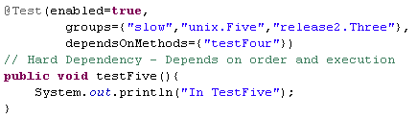
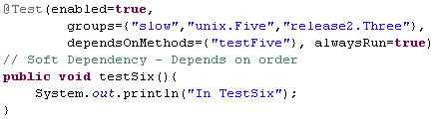
TestNG – Dependency
Dependency to construct our own symphony both in order and based on dependency
Independent Method
Hard Dependency – Maintains the order of run,
It will be skipped if the dependent method fails
Soft Dependency – Maintains the order of run,
but does not fails – run always
Notes:
In JUNIT, there is no test dependency Concept, every test dependency should be hardcoded in JAVA (by method calls) or by Dependency Injection (only for objects) in case if it is an UNIT Test cases
Test dependencies are not JAVA type(class) dependencies.
Types of Dependencies
Based on Hierarchy
Class level – Importing Types, fields, methods
Method level – Method calls, method parameter, return type
Package level – Based on class level
Types of Dependency Injection
Setter
Interface
Constructor
Lookup Reference

Slide 13
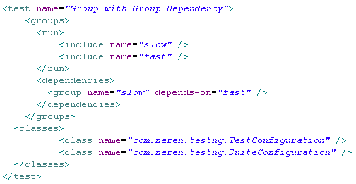
TestNG – Dependency - continued
Dependency based on Groups
Pros of Dependency
Failure does not get propagated as test methods are skipped based on dependency
Dependencies between groups can be done explicitly in xml.
Cautions
When dependency & grouping between methods are declared with annotations & xml, they should go hand in hand – all dependent methods should be grouped together or all groups should include all dependent methods
Notes:
Package & Class grouping can be done for UNIT Testing (Maven folder structure does it always). It is appropriate as the test cases have to be changed based on the changes done in application packages and classes.
For Screen level testing Custom grouping concept can be used else packing & classification should be based on Screens – Page Object Pattern. Here based on screen changes the grouping need to be changed.
Integration test case which become cross functional demands Custom grouping where package and classification will not be enough.

Slide 14
Data Provider – Parameters , Data Providers & Factories
Parameter – for simple data – String & Number, from XML
Data Providers – for complex data / Types – Objects, from Class
Provides various data sets to a test method, Static Data
Factories – for Dynamic Data both simple & Complex, from Class Instantiates Test Classes Dynamically with different sets of data or single set repeatedly

Slide 15
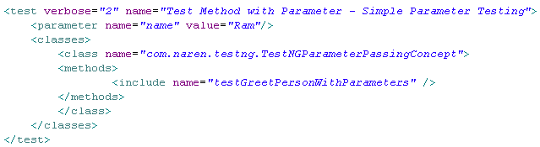
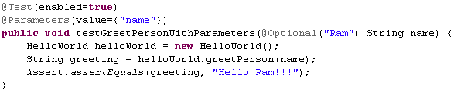
TestNG – Parameter
Parameters
Parameters can be provided at Suite, Test and at Class scope
Parameter Provision through XML
Notes:
Parameters are passed for a TEST or SUITE. In JUNIT static variables are used to for such purposes. Here it can be configured in XML if it is a simple parameter.
If the parameter is complex -> Data Providers can be used. Instead of single data, Data Providers can provide a list of data.

Slide 16
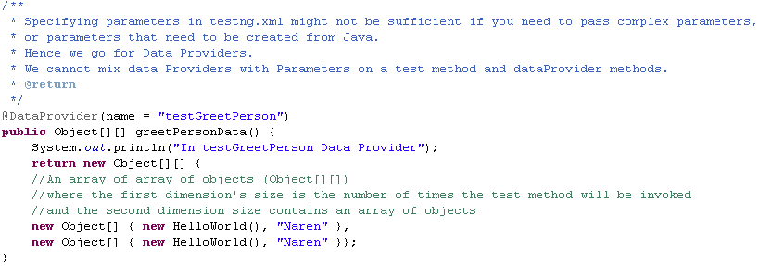

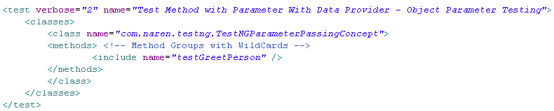
TestNG – Data Provider
Data Providers

Slide 17
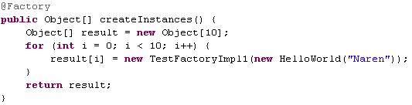
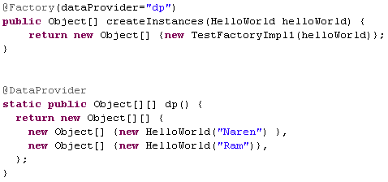

TestNG – Factory
To configure / generate / create test cases dynamically
Factory – To create different instance of test Class repeatedly
Factory – with Data Provider

Slide 18
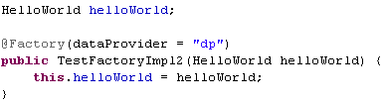
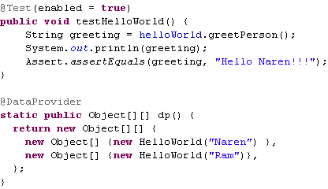
TestNG – Factory - continued
Factory – Constructor Factory
Pros of Data Providers
Can pass input / output parameters with ease
With Factories generation of required parameters can be done with ease

Slide 19
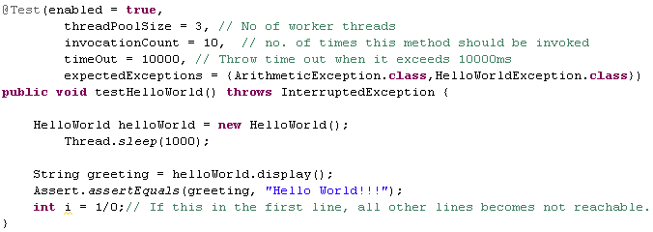
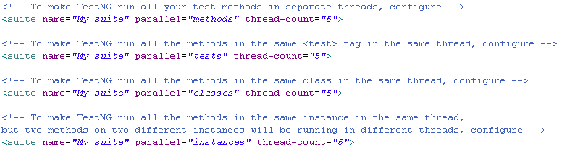
TestNG – Parallel Execution & Time Out
More Configurations

Slide 20
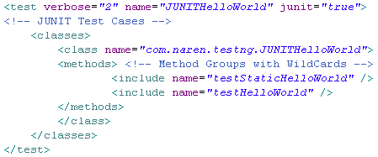
TestNG – Exception Capture
TestNG – JUNIT Run

Slide 21
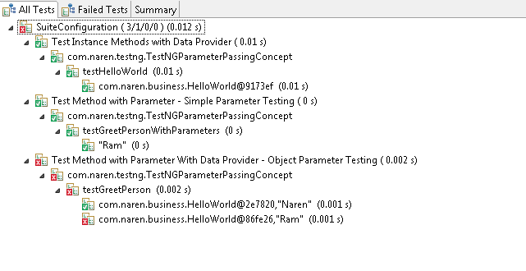
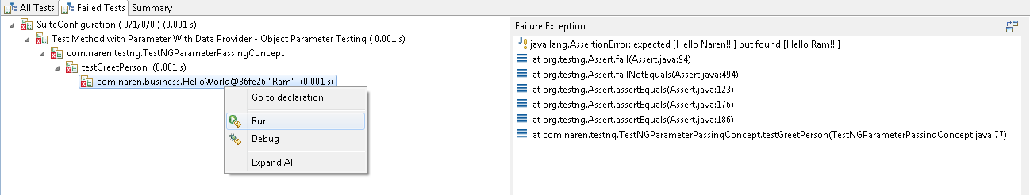
TestNG – Failure Run
TestNG Failed / Skipped tests are tracked, they can be run after correction,
either with IDE or with testng-failed.xml generated by Test NG

Slide 22
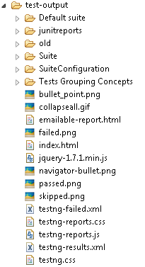
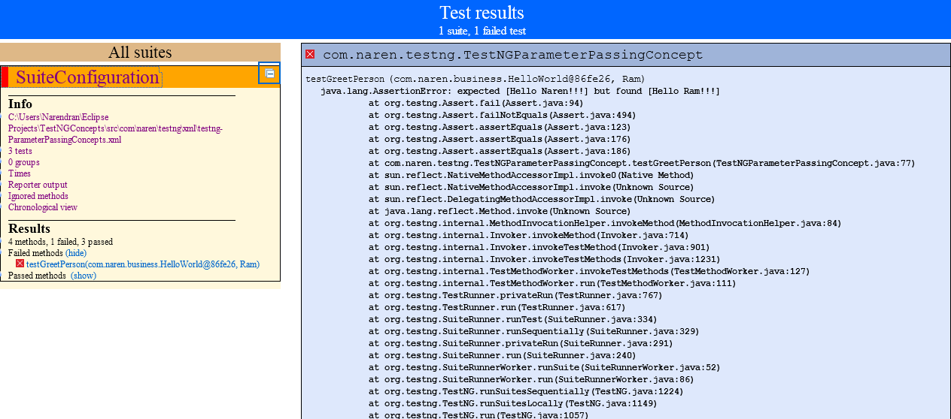
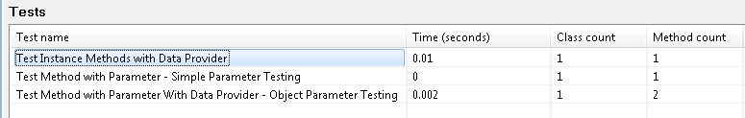
TestNG – Failure Run
TestNG Generates the reports in IDE, in the form of XML, HTML
In Eclipse IDE

Slide 23

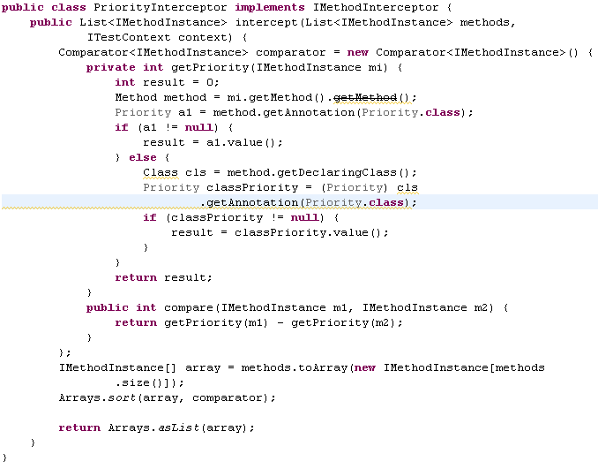
TestNG – Listener & Method Interceptor Implementation
Priority Annotation
Method Interceptor & Annotation Parser

Slide 24
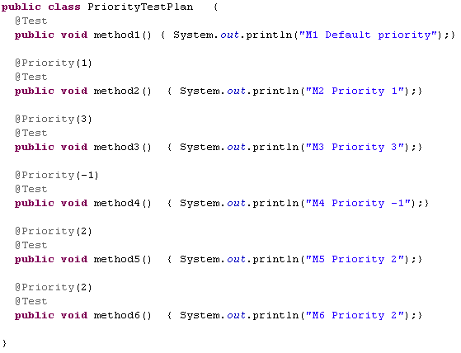
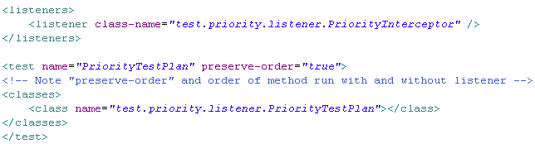
TestNG – Listener & Method Interceptor Implementation
Test Class with Priority annotations
Listener Configuration

Slide 25
TestNG – Tips
To Run Test cases as in written order, configure
To Run Test Cases with instances (for factory) in given order, configure

Slide 26
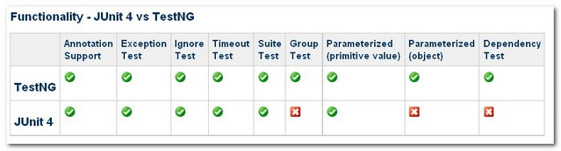
JUnit vs TestNG
Feature | JUnit 4 | TestNG
test annotation | @Test | @Test
run before all tests in this suite have run | – | @BeforeSuite
run after all tests in this suite have run | – | @AfterSuite
run before the test | – | @BeforeTest
run after the test | – | @AfterTest
run before the first test method that belongs to any of these groups is invoked | – | @BeforeGroups
run after the last test method that belongs to any of these groups is invoked | – | @AfterGroups
run before the first test method in the current class is invoked | @BeforeClass | @BeforeClass
run after all the test methods in the current class have been run | @AfterClass | @AfterClass
run before each test method | @Before | @BeforeMethod
run after each test method | @After | @AfterMethod
ignore test | @ignore | @Test(enbale=false)
expected exception | @Test(expected = ArithmeticException.class) | @Test(expectedExceptions = ArithmeticException.class)
timeout | @Test(timeout = 1000) | @Test(timeout = 1000)

Slide 27
Continued..
Other Features present only in Test NG
Clean Parallel Processing with Thread pools, without using Thread class.
Annotation Transformers, Dependency Injection, Listener for plugging in new reporting & modifying run time test scripts executions are present.
To run JUNIT test cases with TestNG
To convert JUNIT test cases into TestNG test cases.
For Simple Unit Testing it does not matter whether we use JUnit or TestNG, but when we go for TDD, Integration & end to end testing, skipping of test cases based on logical & fail fast dependencies & Parameterized testing, clean Multithread testing, testing groups will help a lot.
As of now, JUnit is popular for Unit Testing, TestNG is more complete & Clean & popular for TDD, Integration & end to end testing.

Slide 28
Observations
XML Configuration failures are not considered as failures, though throws exception in log file
Groups, Sub Groups makes random grouping and dependencies
Structural & Random Dependencies

Slide 29
Groups vs Universes
We can classify & group test cases as UNIT, INTEGRATION & SMOKE and with in this groups we could have Business functional segregations.
School of tests which has to be run has to be grouped.
Groups formed should be mutually exclusive.
If Groups are not mutually exclusive, there should be another group formed which combines all non exclusive groups without redundancy.
A Group can have “N” no. of mutually exclusive sub groups.

Slide 30
TestNG – Links
TestNG Documentation
http://testng.org/doc/documentation-main.html
TestNG Download
http://testng.org/doc/download.html

Slide 31
Questions?

